Slide 1
Mapping
DIGH 5000
December 8, 2017
Cristina Wood

Slide 2
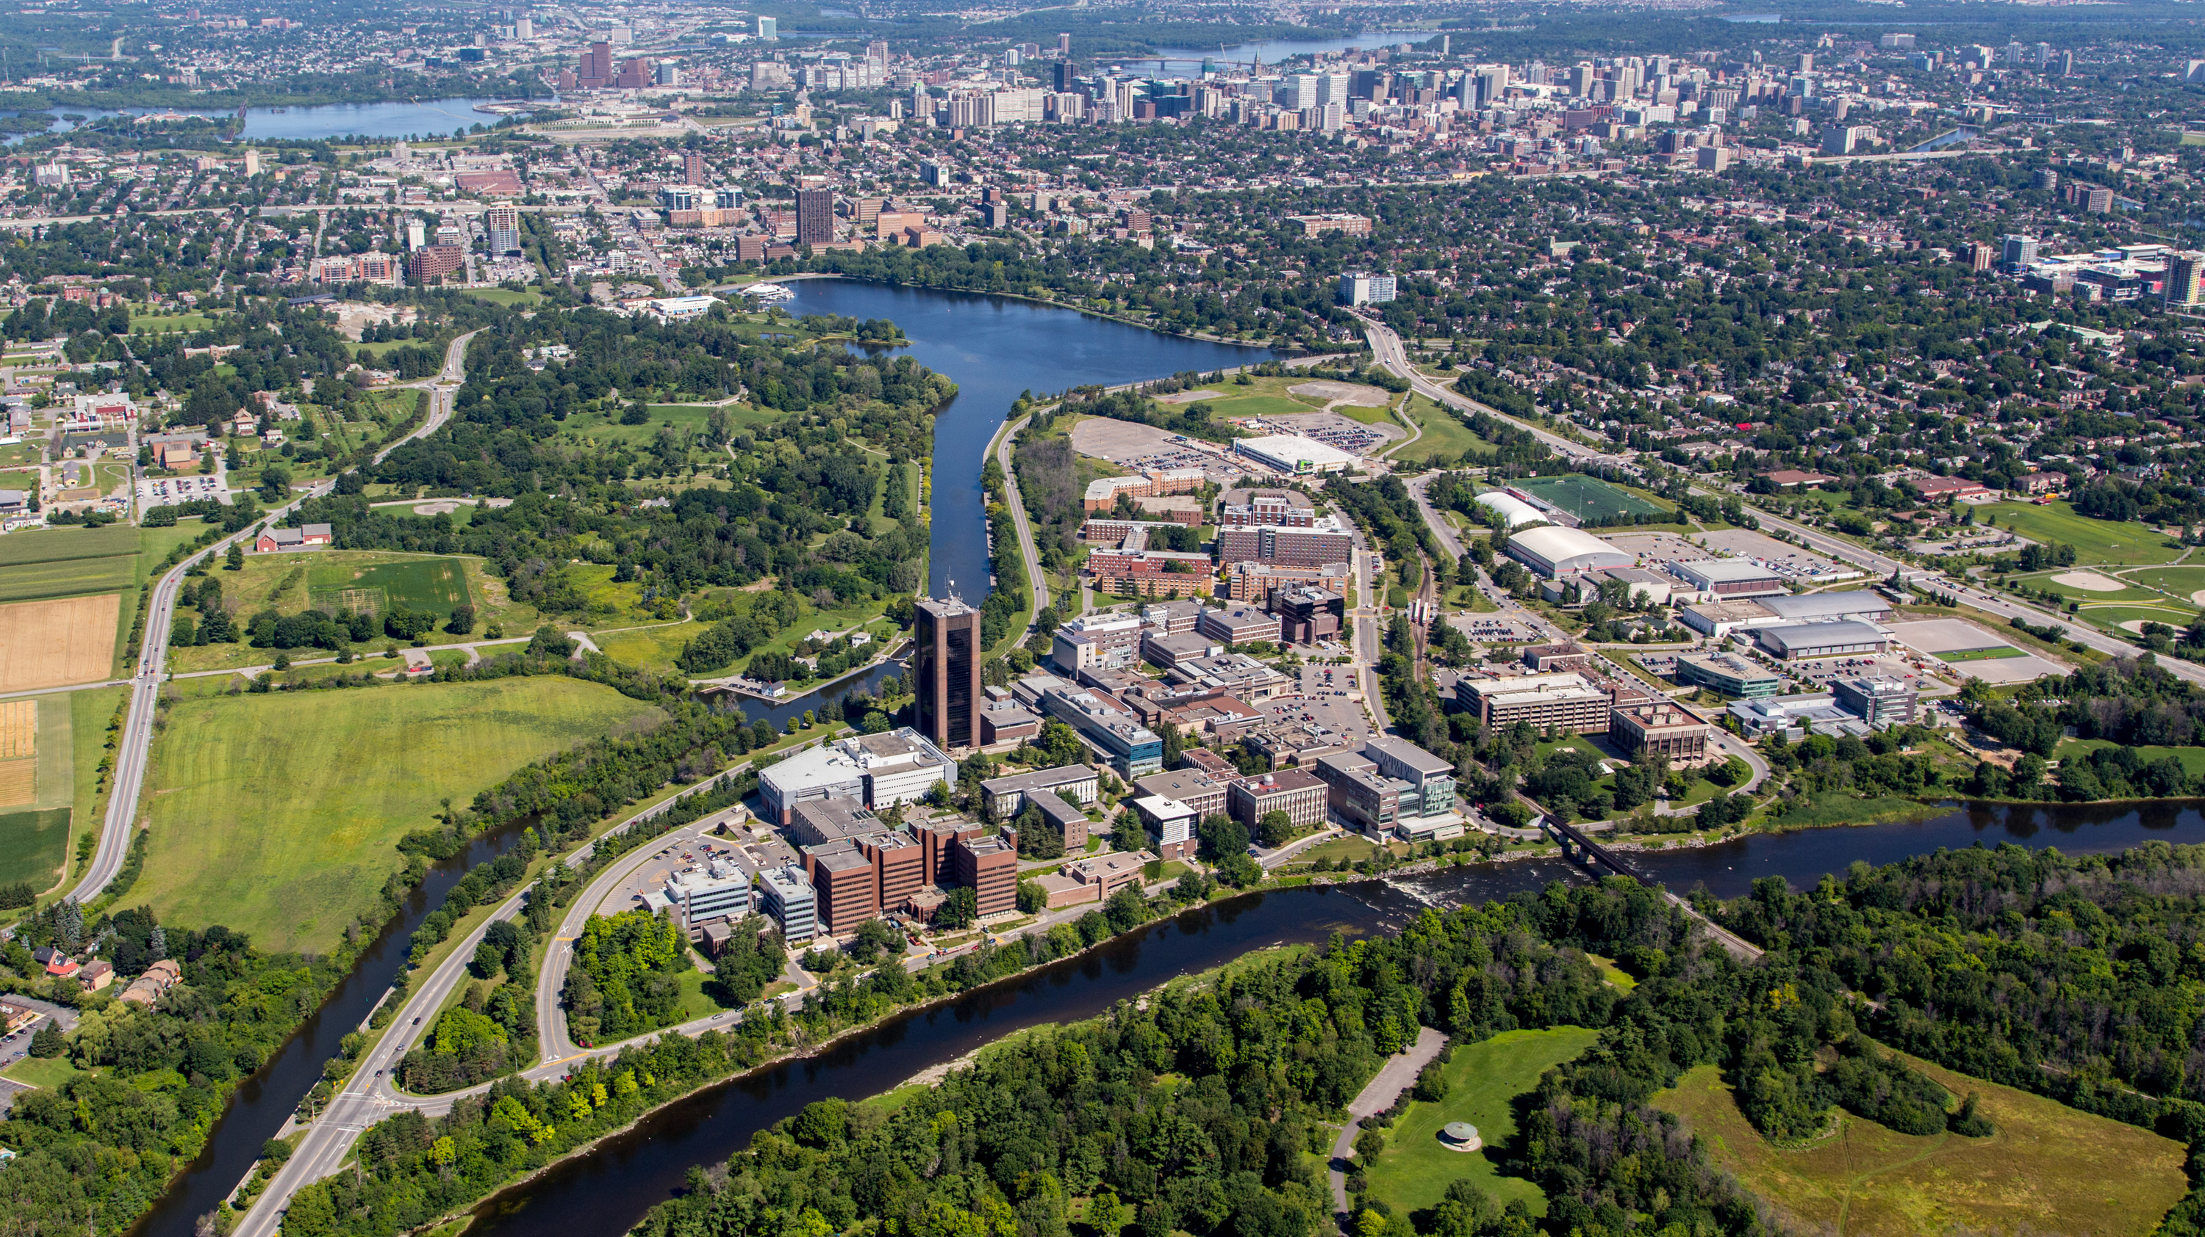
Notes:
How does this…

Slide 3
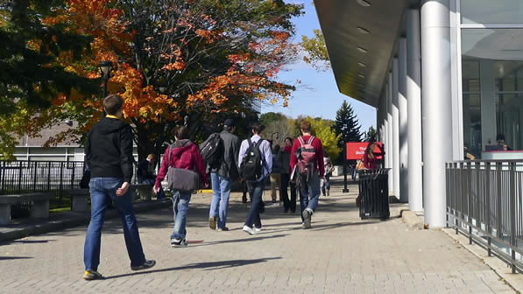
Notes:
Or this

Slide 4
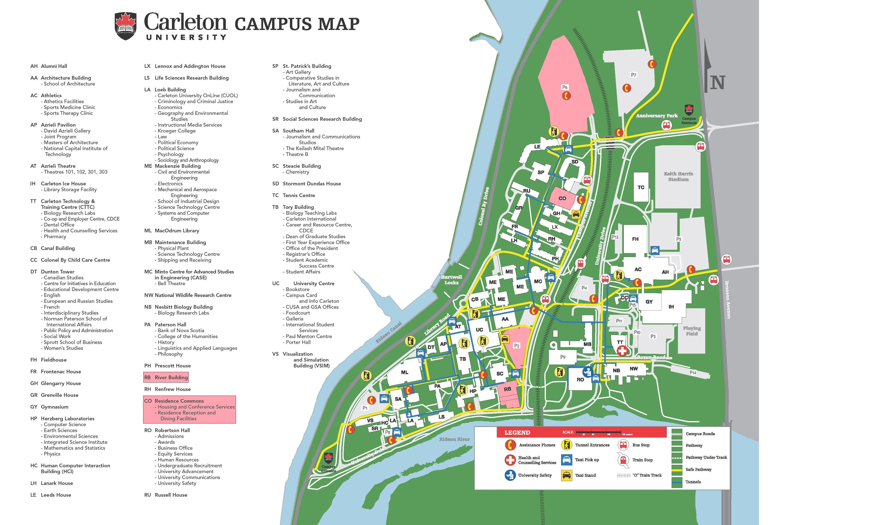
Notes:
Become this?

Slide 5
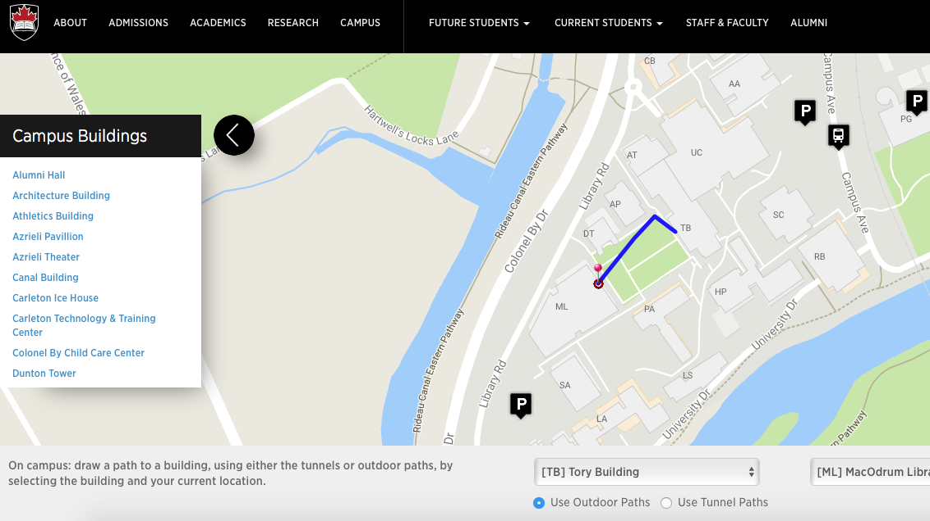
Notes:
And how does the paper version interact with/become this…

Slide 6
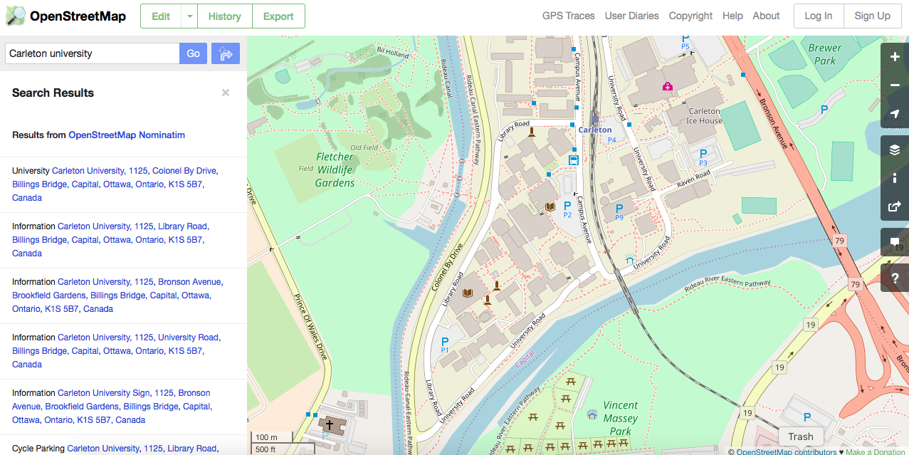
Notes:
And then this. This is a site called Open Street Map, a community-driven mapping site which allows local users to contribute to and maintain maps. I’d like us first to consider this, side by side with the Google Maps view of Carleton Campus.
For those conferencing in, one side of the room is going to look at OpenStreetMaps and the other will look at Google Maps and present their impressions. Please feel free to contribute your impressions! Here’s OpenStreetMap: https://www.openstreetmap.org/#map=19/45.38134/-75.69801

Slide 7
What do they share? Where do they differ? What does each offer?
Notes:
For those conferencing in: we’re going to fill the answers to these questions in on the whiteboard. We will remember to share that with you! Please contribute if you’d like.

Slide 8
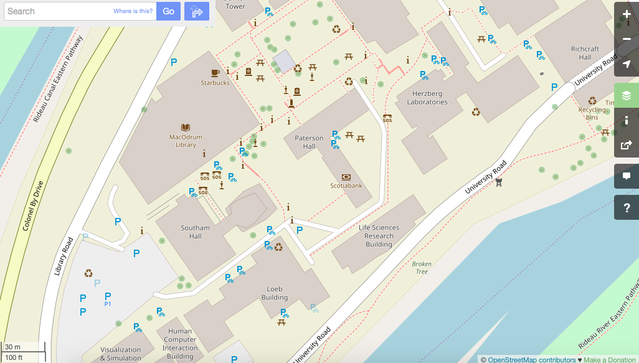

Slide 9
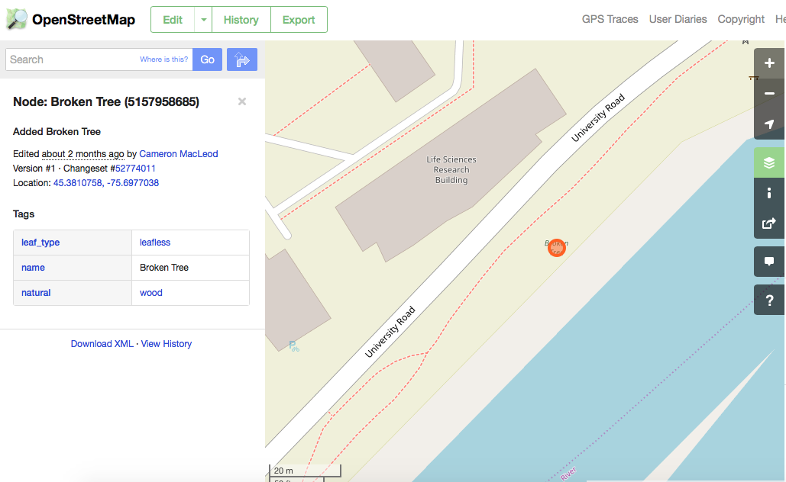
Notes:
The Broken tree on the path was tagged. What does this change about the map?

Slide 10
Defining mapping in the digital humanities
Notes:
For those conferencing in, we’re now going to take the ideas from that comparison exercise and the evolution of representations of Carleton campus (from the aerial view image and in situ image, to the paper map with points and a legend, to the interactive Carleton map, to the OpenStreetMap) and come up with some definition ideas for mapping. Specifically in defining, let’s consider what the humanities bring and how the projects/readings inform this definition.

Slide 11

Going Deeper

Slide 12
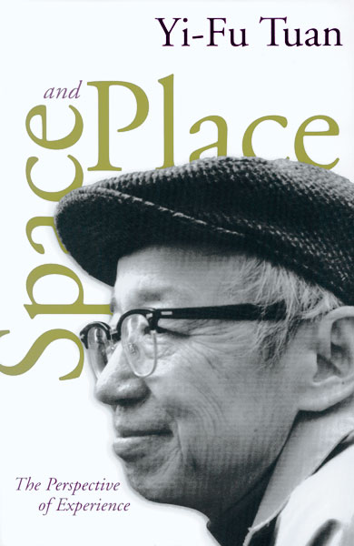
Space and Place
What we cannot say in an acceptable scientific language
we tend to deny or forget. A geographer speaks as though
his knowledge of space and place were derived exclusively
from books, maps, aerial photographs, and
structured field surveys. He writes as though people were
endowed with mind and vision but no other sense with
which to apprehend the world and find meaning in it. He
and the architect-planner tend to assume familiarity –
the fact that we are oriented in space and home in place
– rather than describe and try to understand what
‘‘being-in-the-world’’ is truly like.
- Yi-Fu Tuan, 1977: 200–201
Notes:
For those conferencing in: this quote comes from Yi-Fu Tuan’s 1977 critique of a simple space, defined by location and distance. He proposed incorporating the human experience into geography, adding place to space. The next few slides will explore space and place, and the evolution of scholarship in conceiving of those notions.

Slide 13
Tim cresswell on Place
“conception of place describes a way of relating to the world” (Cresswell 4)
There is a “distinction between an abstract realm of space and an experienced and felt world of place” (Cresswell 4)
Place is marked by experience, dwelling (Heideggerian dasein) but recent human geography considers “placelessness and nonplace.” These are “marked by a lack of attachment, by constant circulation, communication and consumption” (Cresswell 5)
Notes:
Cresswell was cited in Diana Sinton’s intro to mapping in Digital Pedagogy in the Humanities. He explores how humanists can complicate, deepen their understanding of place and space.

Slide 14

Notes:
Mobility as a threat to place? Shopping malls as placeless.

Slide 15
Doreen Massey
Suggests that: “…places are actively constituted by mobility – particularly the movement of people but also commodities and ideas. Places to Massey are not clearly bounded, rooted in place, or connected to single homogeneous identities but produced through connections to the rest of the world and are therefore more about routes than roots” (in Cresswell, 8).
Calls this “a progressive sense of place.”

Slide 16
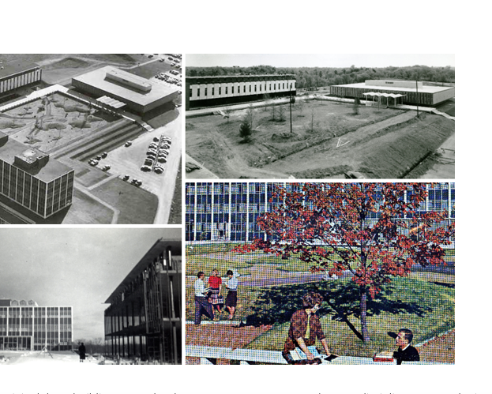
Exercise: Mapping the “construction U” exhibit
The exhibit: https://arc.library.carleton.ca/exhibits/construction-u
Shawn’s instructions: https://www.youtube.com/watch?v=KgLrvcA8v_M
My instructions: https://github.com/cristinawood/dhcu-teaching/blob/ghpages/December%208%20DIGH%205000.docx
Notes:
For those conferencing in, follow this link to Shawn’s instructions https://www.youtube.com/watch?v=KgLrvcA8v_M and to my instruction sheet to follow along https://github.com/cristinawood/dhcu-teaching/blob/gh-pages/December%208%20DIGH%205000.docx

Slide 17
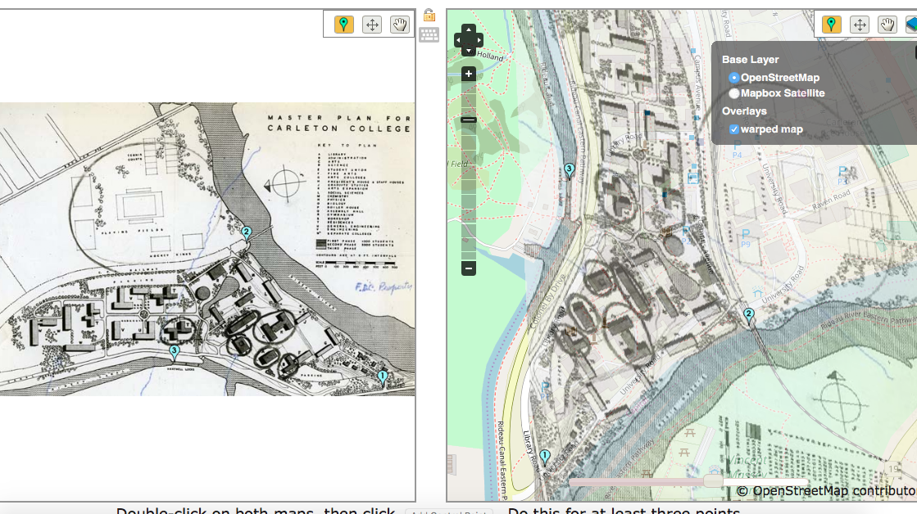

Slide 18
Writing The Book
Notes:
What do we do about embodied GIS? How can we add place to space in the digital humanities? What questions have we missed? We are going to have a discussion to finish up, and hopefully lead into a discussion about our textbook.

